Slide 1



WireShark Protocol and Malware Analysis
Go Deep
Notes:
Welcome to Wireshark Protocol and Malware Analysis.
This presentation will cover some basic protocols and how by searching through packet captures we can determine cause / affects and detect malicious traffic on our network.

Slide 2
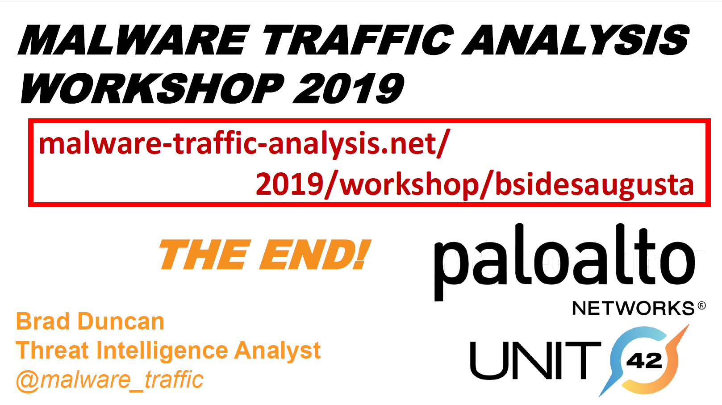
Notes:
slides and Pcaps used in this presentation were obtained in part from the malware traffic analysis workshop 2019 at B-sides Augusta.
Originally presented by Brad Duncan who is a threat intelligence analysist for Paloalto networks and a member of Unit 42.
find him on twitter @malware_traffic

Slide 3


History
Wireshark has a very rich history. Gerald Combs, a computer science graduate of the university of Missouri at Kansas City, originally developed it out of necessity. The first version of Comb’s application called Ethereal, was released in 1998 under the GNU GPL (GNU Public License). Eight years after releasing Ethereal, Combs left his job to pursue other career opportunities. Unfortunately, his employer at that time had full rights to the Ethereal trademarks, and Combs was unable to reach an agreement that would allow him to control the Ethereal brand. Instead, Combs and the rest of the Development team rebranded the project as Wireshark in mid 2006.

Slide 4



Notes:
There's a few other tools out there that do a good job of packet analysis. Text-based tools such as TCDUMP if your really familiar with wireshark filtering you can simply enter your search string and load the PCAP It saves time but is for the more advanced user.
Network miner is fantastic for more automated tools that displays all the information in an easy to read format. AKA Cheat Mode.
Then there's online tools such as Packet Total.

Slide 5


Wireshark Go Deep
Notes:
Wire Shark offers several benefits that make it appeal for everyday use, Aimed at both the Up and Coming and the expert Packet analyst. It offers a variety of features to entice each.
The Security industry needs more people with an understanding of how internet protocols work and can filter through traffic without relaying on tools to automate IOC’s
Go Deep is actually wire sharks catch phrase.
my Wireshark screen different then default
can provide the custom profile.

Slide 6
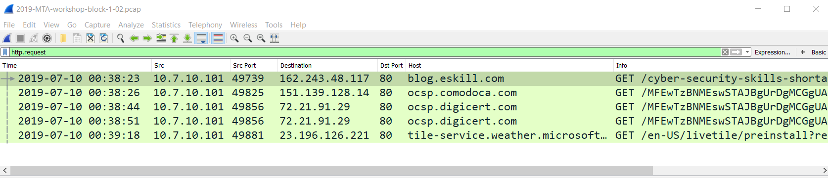
HTTP. Request
Notes:
An Http Request is a packet of information that one computer sends to another computer to communicate something. To it’s core, http request is a packet ofbinary data sent by the client to the server. An Http request contains the following parts.
Request line
Headers, 0 or more headers in the request
An optional body of the request.

Slide 7
Notes:
Looking at the Pcap with an HTTP request filter we can see it comes across port 80, which we all know is the commonly used internet communication protocol. Hypertext transfer protocol. It’s the port from which a computer sends and receives web client-based communication and messages from a web server and is used to send and receive html pages or data.

Slide 8
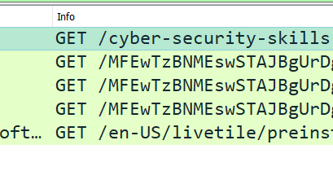
Notes:
Scrolling over to the info column we can see the Get/ Request URI string,
GET is used to request data from a specified resource.
As apposed to the POST request which is used to SEND data to a server.

Slide 9
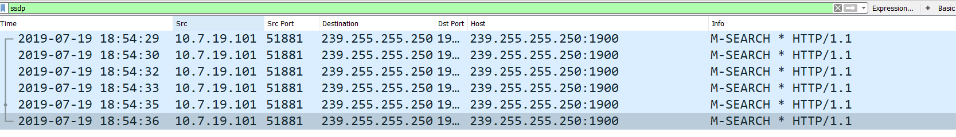
SSDP Simple Service Discovery Protocol
Notes:
Http Trafficon UDP port 1900 is Simple Service Discovery Protocol (SSDP) traffic.
The SSDP Protocol can discover Plug & Play devices, with uPnP (Universal Plug and Play.)
SSDP uses unicast and multicast address (239.255.255.250)

Slide 10
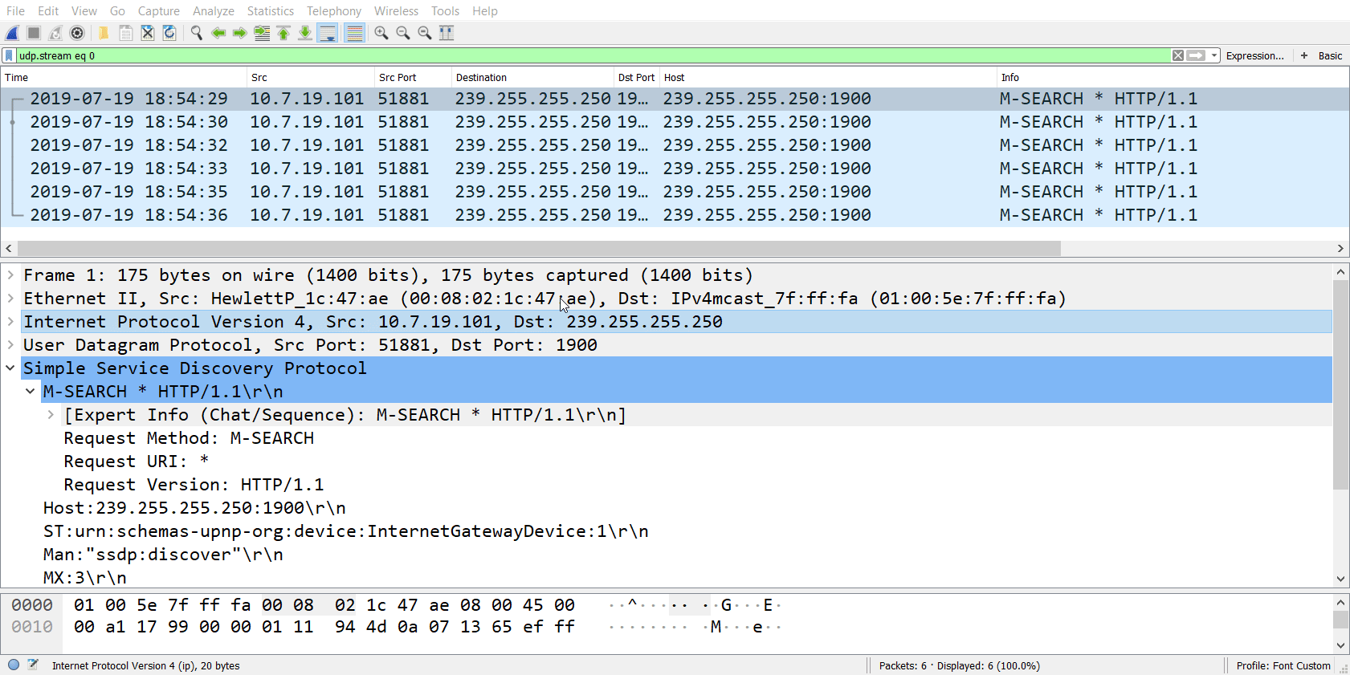
Notes:
Following the UDP trace

Slide 11
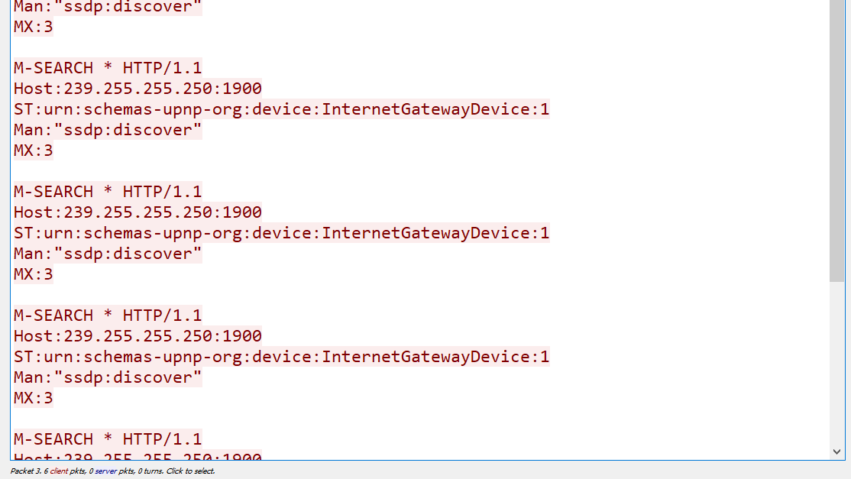
Notes:
You can see it states SSDP Discover and universal plug n play device. Internet gateway. With a multicast address.
This traffic is largely irrelevant and we will filter it out.

Slide 12
(http.request or ssl.handshake.type == 1) and !(ssdp)
Notes:
The value HTTP. Request reveals URLS for http request
Tls handshake.type ==1 reveals domain names used in https or SSL or TLS traffic.
SSL is deprecated in favor of TLS wherever you would use ssl.[element] use tls.[element]

Slide 13
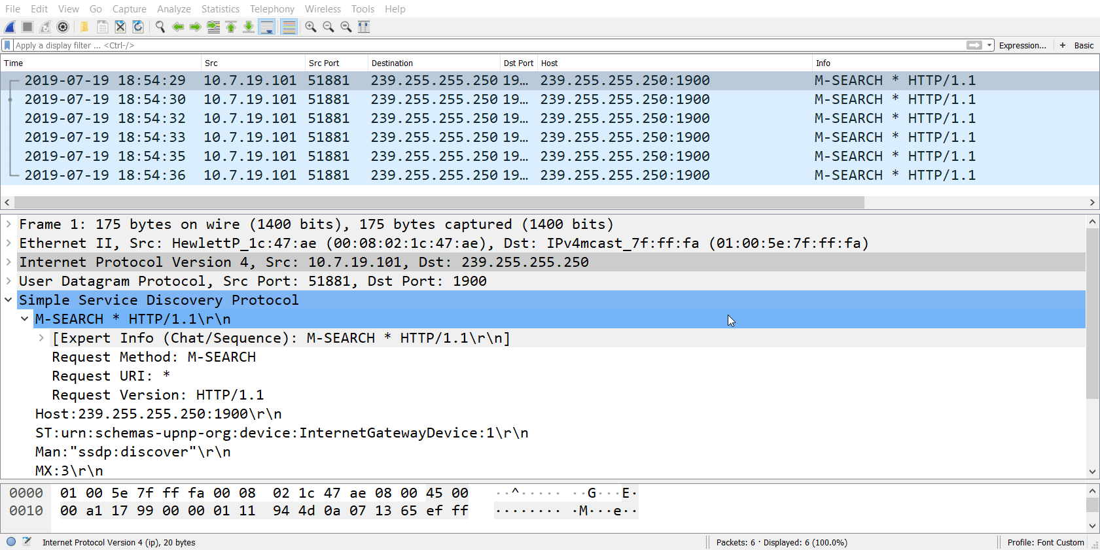
Notes:
Filtering out this SSDP traffic, we’re left with much more relevant information.
Which when you filter you can see nothing is in this PCAP. The hosta all display the multicast address which is UDP –SSDP

Slide 14
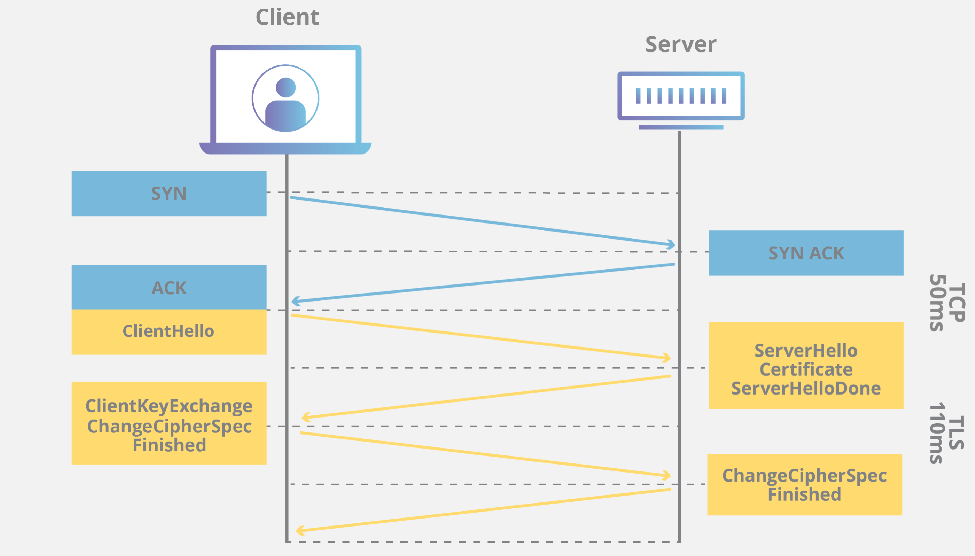
Notes:
The SSL handshake comes in two flavors. Single and double
The ==1 which we filtered for is the first part of the ssl handshake. The “Client Hello” which happens after the TCP 3-way handshake.
SYN>SYNACK > ACK

Slide 15
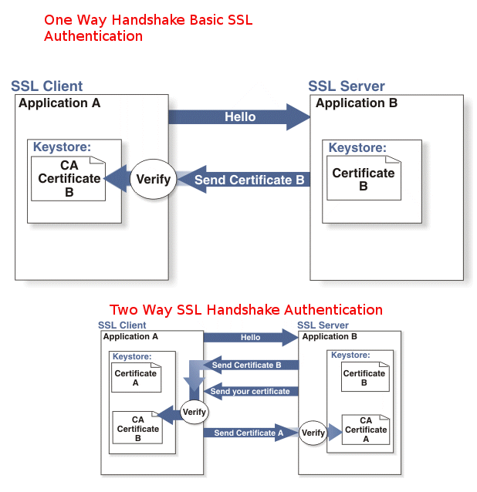
Notes:
The difference between singe and double SSL is that one-way SSl only the server authenticates to the client whereas, in two-way SSL, both server and client authenticate to each other. Usually, when we browse an HTTPS website, one-way SSl is being used where only our browser (client) validates the identity of the website (server) Two way SSL is mostly used in server to server communication where both parties need to validate the identity of each other.

Slide 16
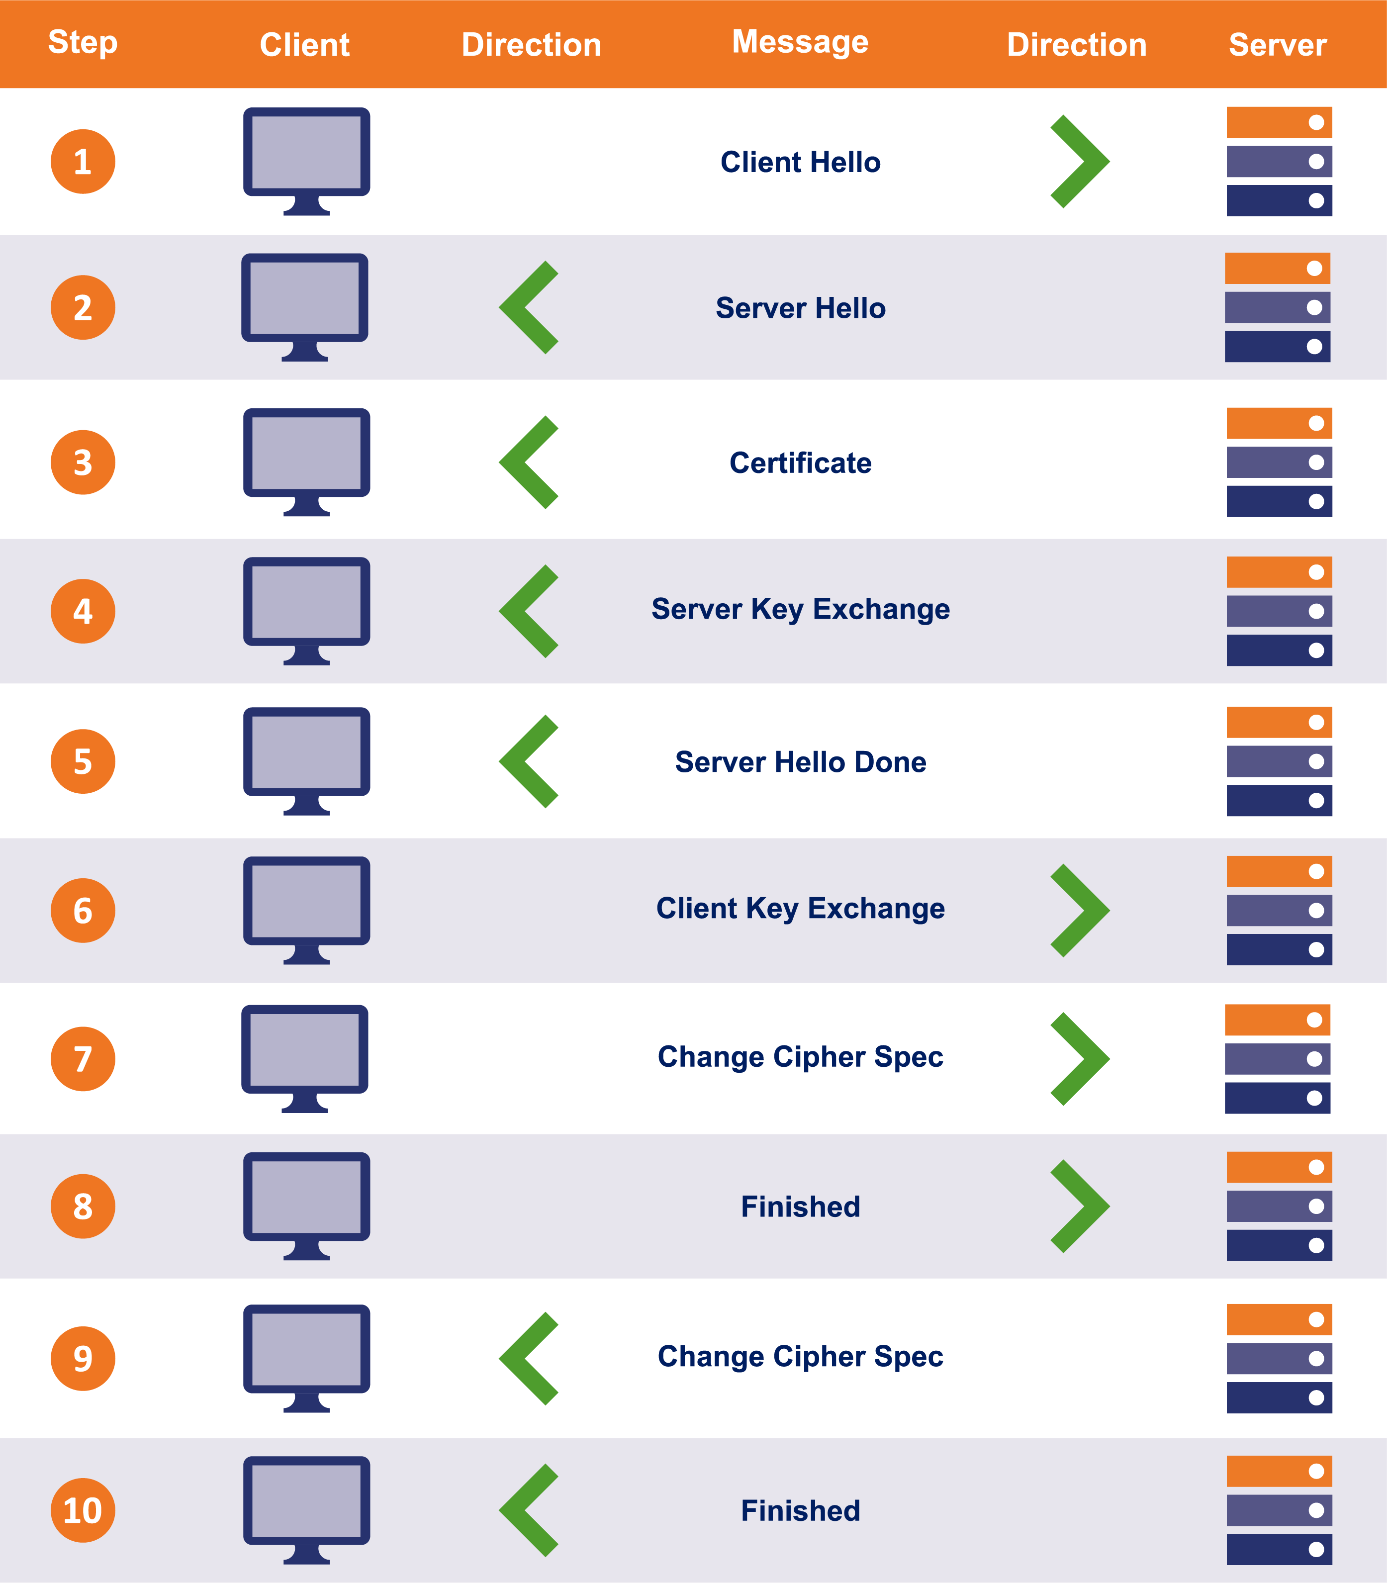
Notes:
As stated before the SSL (tls) handshake occurs you go through the syn Ack TCP 3 way handshake.
Then the SSl handshake follows as a CLIENT HELLO. Which is what we are filtering for.
CLIENT HELLO notifies the server its support for the TLS version and the list of ciphers it supports.
SERVER HELLO responds back with the configuration it selected from the client hello along with its information to proceed with the next phase of the handshake.
The server will select the TLS version according to the lower of that suggested by the client, and the highest supported by the server. The server also sends the certificate chain to be validated against the certs in the clients trust store.
We will skip through the rest.
Server key exchange message
Certificate request
Client certificate
Client key exchange message
Finish.
After successful authentication and generating pre-master secrets/master secrets, a change cipher spec message will be sent by both client and server indicating that the rest of the communication will be encrypted.
The finished message will immediately follow the change cipher spec message.

Slide 17
Identifying information
Host information
Operating system and web browser
Windows account name in AD environment from Kerberos Traffic

Slide 18
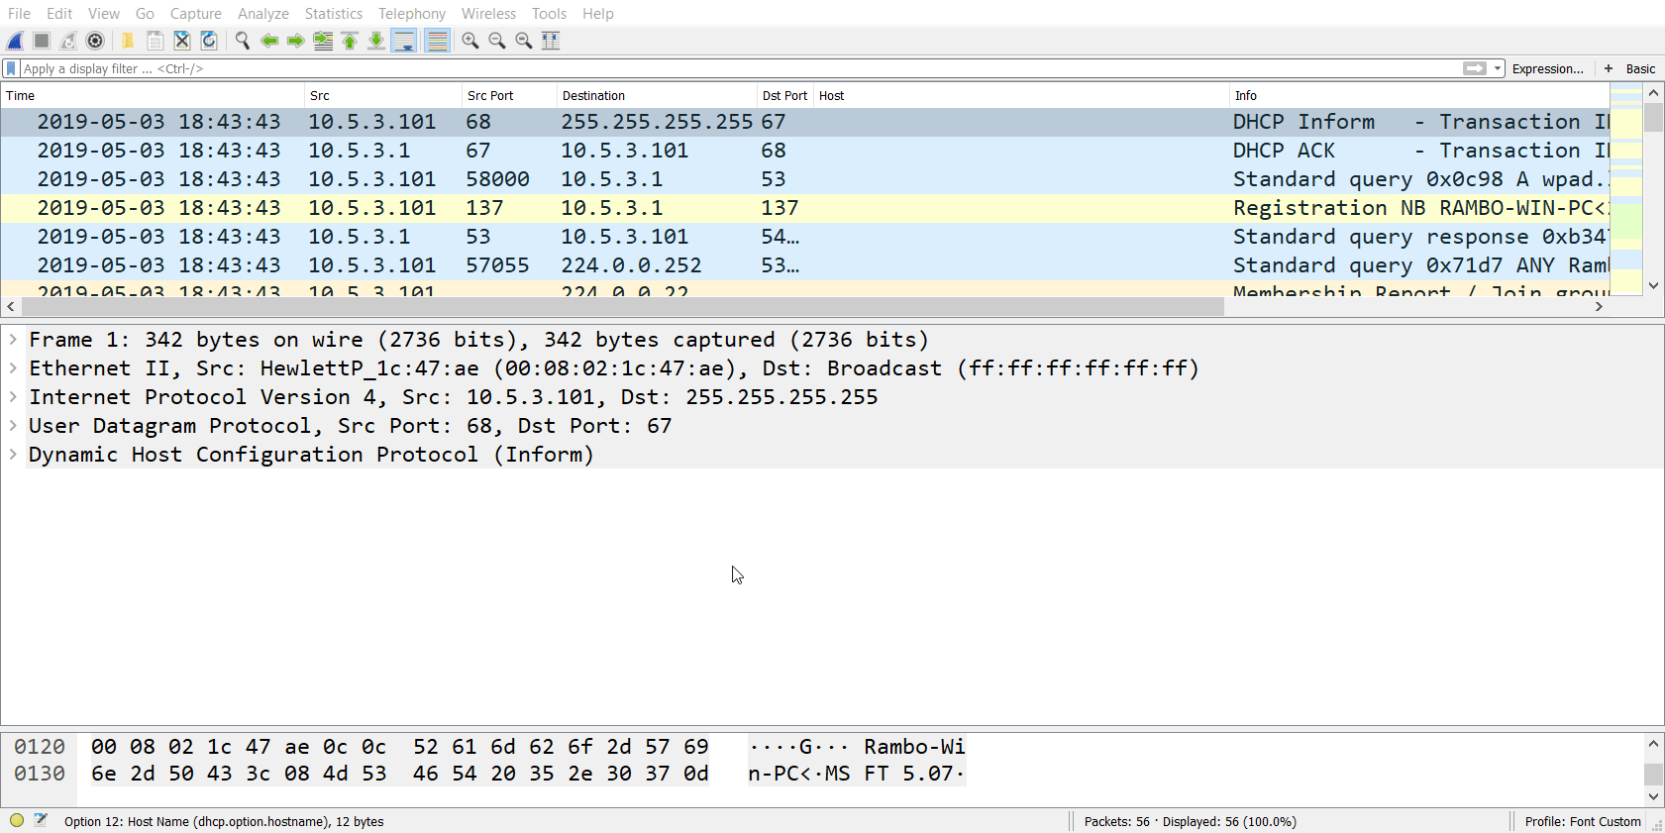
DHCP
Notes:
DHCP: Dynamic Host configuration protocol is a network management protocol used on UDP/IP networks whereby a DHCP server dynamically assigns an IP address and other network configuration parameters to each device on a network , that they may communicate with other IP networks.
Filtering the pcap for DHCP traffic should allow us to gain the hostname.

Slide 19
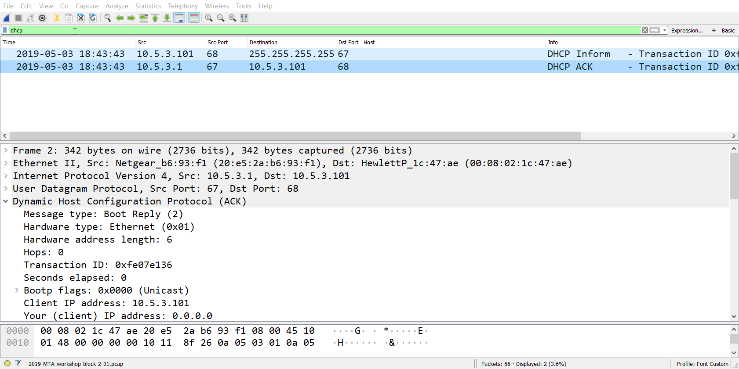
Notes:
NBNS
Sometimes called WINS (Windows internet Name Service) stands for net bio name service, which is a protocol for name resolution. NBNS performs the same function as LLMNR but using UDP broadcast packets instead of Multicast
Can anyone tell me what that means?
UDP (User datagram protocol is an alternative communications protocol to TCP (transmission control protocol). Used primarily for establishing low-latency and loss-tolerating connections.
Difference between TCP and UDP?
“I’ll send it to you, but I don’t care if it gets there.”

Slide 20
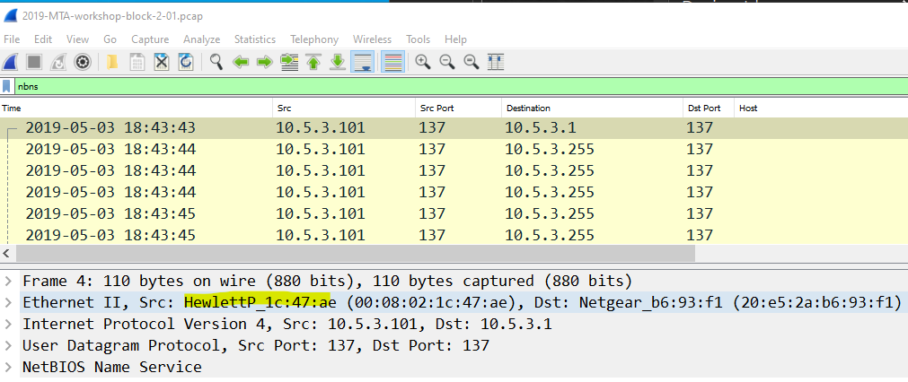
Notes:
Filtering for NBNS were now seeing the source IP. The hostname and the type of machine
So by filtering by these two protocols we can gather windows host information.

Slide 21
Identifying information
Host information
Operating system and web browser
Windows account name in AD environment from Kerberos Traffic
Notes:
Were going to filter for operating system and web browser.

Slide 22
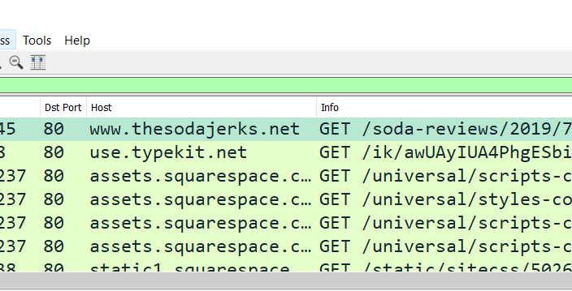
Notes:
by filtering for http.request
was searching Soda Jerk reviews for Meow tan dew.

Slide 23
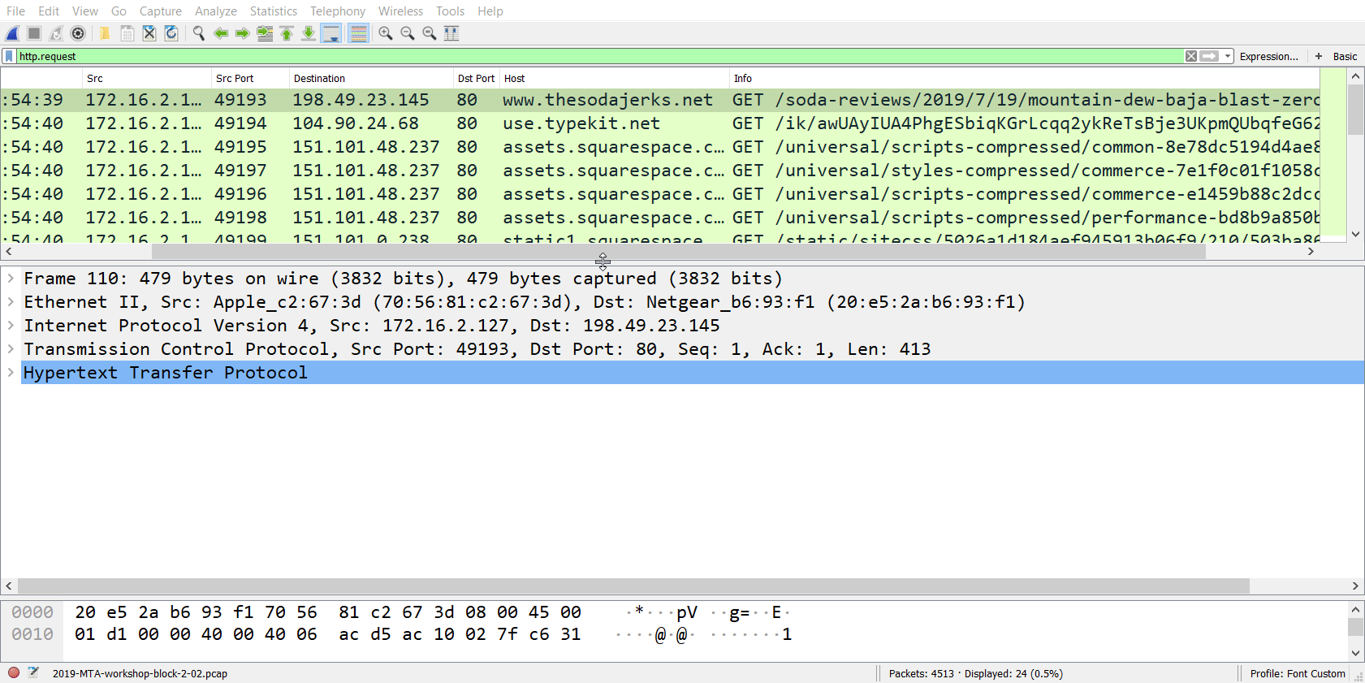
Notes:
Following the TCP flow we can see the model of the device in use. The browser and the encrypted traffic from after the handshake.

Slide 24
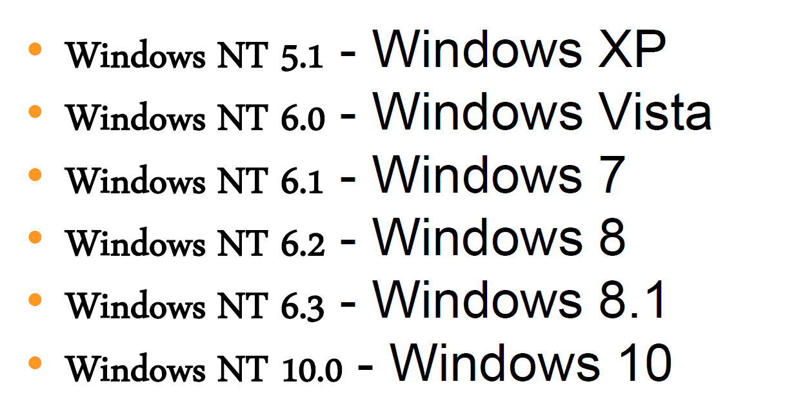
Notes:
Listing of Windows

Slide 25
Identifying information
Host information
Operating system and web browser
Windows account name in AD environment from Kerberos Traffic
Notes:
B2-P7
Basic filtering Pcap and protocol analysis.
Let's dig into something more interesting such as User information using Kerberos.

Slide 26

Kerberos
Notes:
Kerberos is a network authentication protocol. It is designed to provide strong authentication for client/server applications by using secret-key cryptography.
It is a computer-network authentication that works on the basis of tickets to allow node communication over a non secure network to prove their identity to one another in a secure manner.

Slide 27
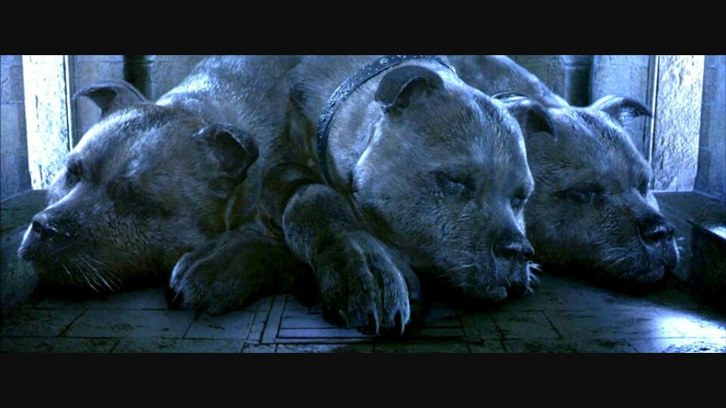
Notes:
Cause I like harry potter
Keeping it as top level as possible we weill break down the Kerberos process.

Slide 28
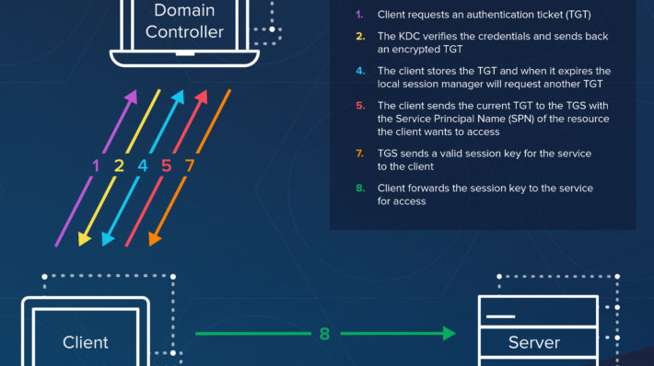
Notes:
Here are the most basic steps taken to authenticate in a Kerberized environment.
Client requests an authentication ticket (TGT) from the Key Distribution Center (KDC) (ticket generating ticket / key distribution center)
The KDC verifies the credentials and sends back an encrypted TGT and session key
The TGT is encrypted using the Ticket Granting Service (TGS) secret key
The client stores the TGT and when it expires the local session manager will request another TGT (this process is transparent to the user) If the Client is requesting access to a service or other resource on the network, this is the process:
The client sends the current TGT to the TGS with the Service Principal Name (SPN) of the resource the client wants to access
The KDC verifies the TGT of the user and that the user has access to the service
TGS sends a valid session key for the service to the client
Client forwards the session key to the service to prove the user has access, and the service grants access.

Slide 29
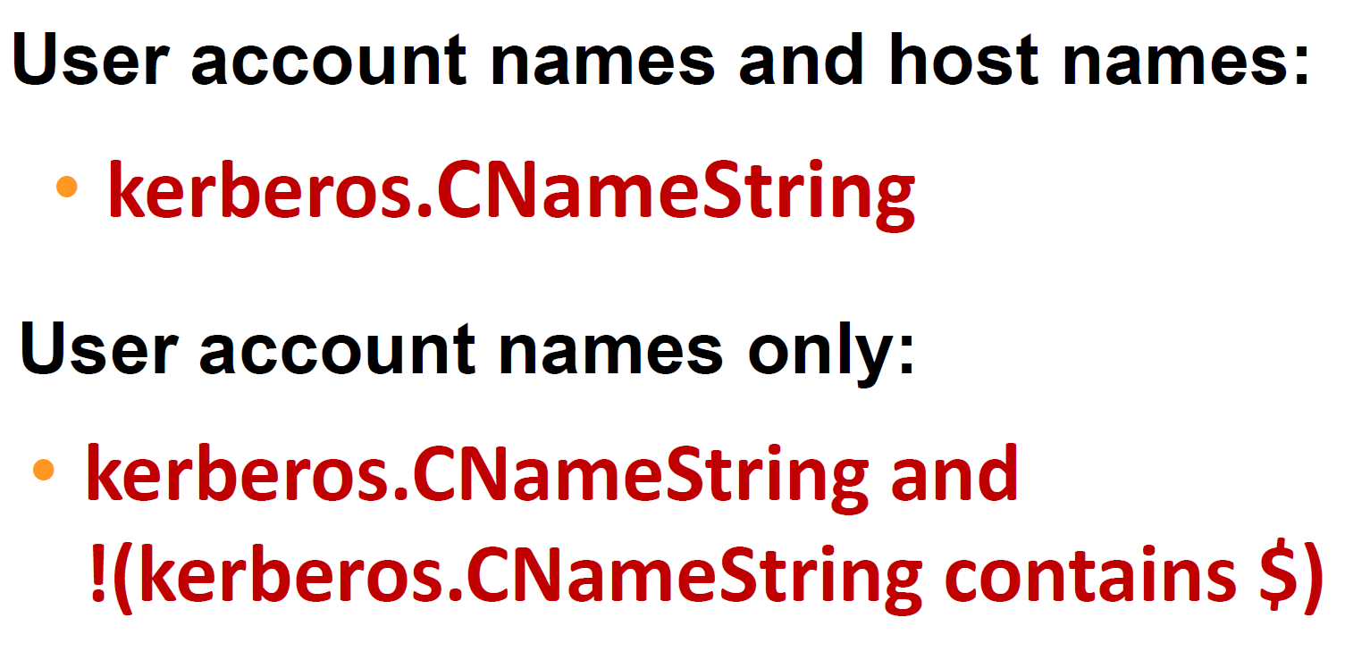
Notes:
Filtering by these two parameters and following the AS-REQ or TGS-REP Kerberos flow we can discover the hostname and user account name.

Slide 30
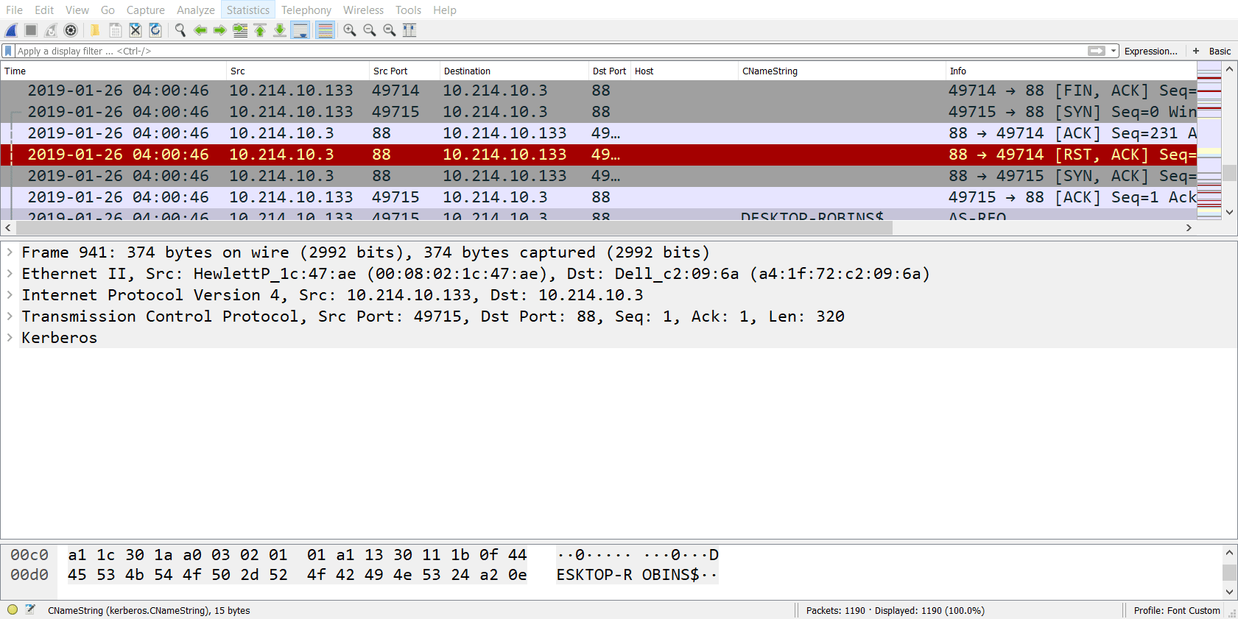

Slide 31
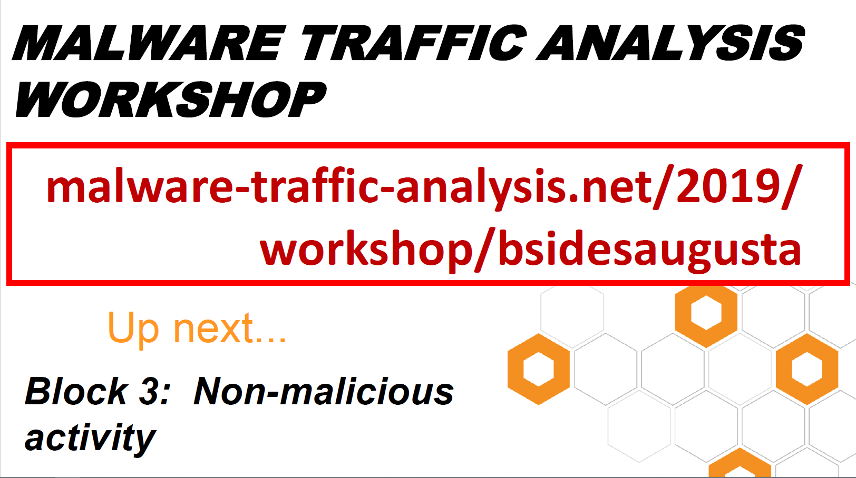
Notes:
Filtering for non malicious activity.
To spot the bad we must know the good right?

Slide 32
Non-Malicious Activity
Filtering for non-web traffic
Email Traffic
FTP Traffic
IRC Traffic
File Transfers over SMB
Traffic caused by Google Chrome

Slide 33
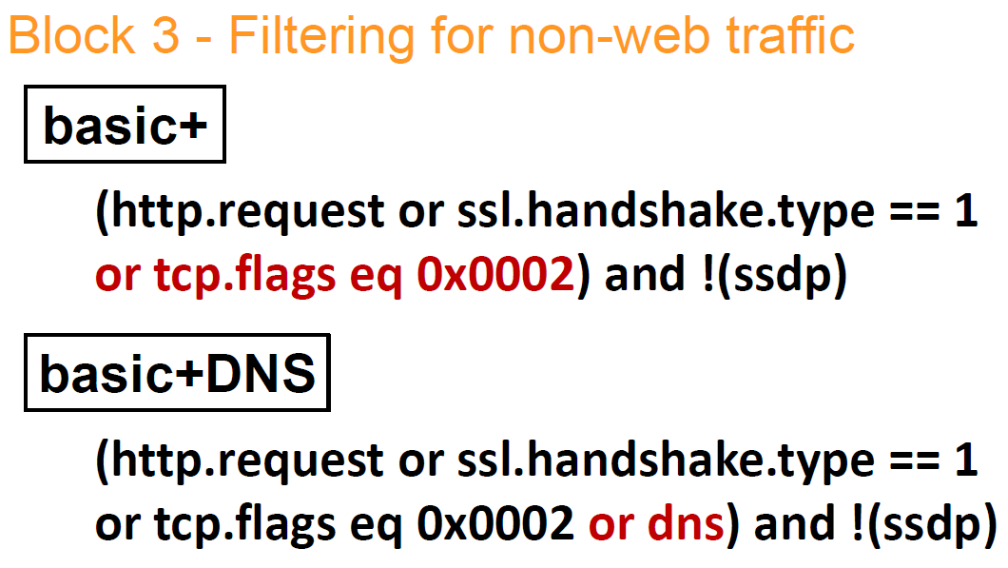
Notes:
I generated 2 filters.
Basic+ Filter, in some cases, an infected host may try to connect with a server that has been taken off-line or is refusing a TCP connection. These attempted connections can be revealed by including TCP SYN segments in your filter.
searches for the HTTP / TLS traffic and the HELLO CLIENT message. OR TCP SYN segments. This can reveal unsuccessful connection attempts by an infected host to other servers.
Basic+DNS
In some cases post-infection traffic will not be web-based and an infected host will contact command and control servers. (C2) these servers can be directly hosted on IP addresses, or they can be hosted on servers using domain names. Some post infection activity, like C2 traffic caused by Nanocore Remote Access Tool (RAT) is not HTTP or HTTPS/SSL/TLS traffic.
Therefore, I often add DNS activity when reviewing a Pcap to see if any of these domains are active in the traffic.
Including DNS queries may reveal attempted TCP connections to additional domains.

Slide 34
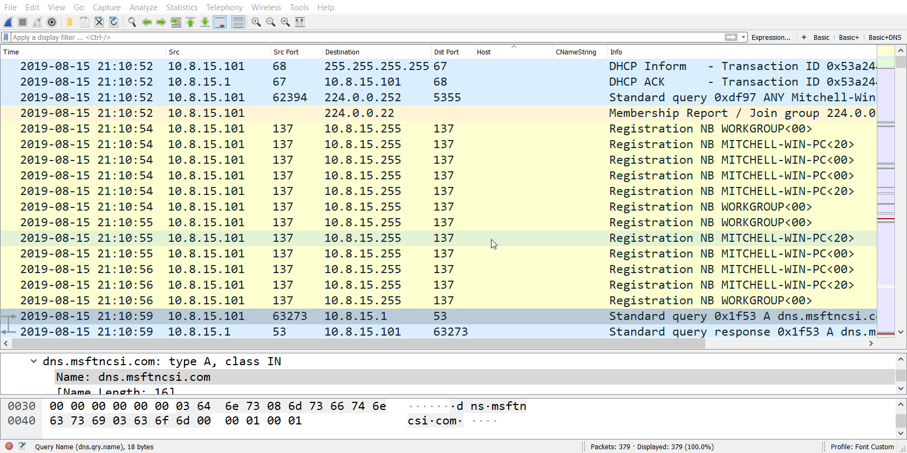

Slide 35
Non-Malicious Activity
Filtering for non-web traffic
Email Traffic
FTP Traffic
IRC Traffic
File Transfers over SMB
Traffic caused by Google Chrome

Slide 36
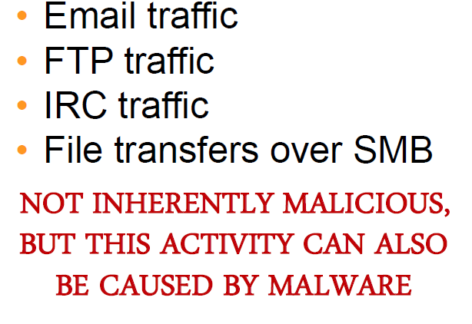
Notes:
Email traffic / FTP Traffic / IC and File Transfer over SMB are not inherently malicious but this activity can also be caused by malware.
Hawkeye keylogger will send passwords and other information every 10 minutes
Even though The email traffic itself is not malicious. The contents of the email may contain malicious data.
Go to LIVE DEMO

Slide 37
Non-Malicious Activity
Filtering for non-web traffic
Email Traffic
FTP Traffic
IRC Traffic
File Transfers over SMB
Traffic caused by Google Chrome

Slide 38
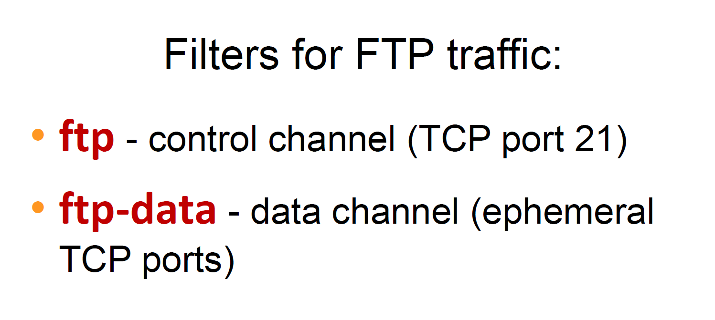
Notes:
ftp- control channel is port 21
ftp-data c ephemeral tcp ports. (Transmission control protocol)
(short lived transport protocol port. ) ephemeral ports are allocated automatically and after completion or time out they become available for reuse.

Slide 39
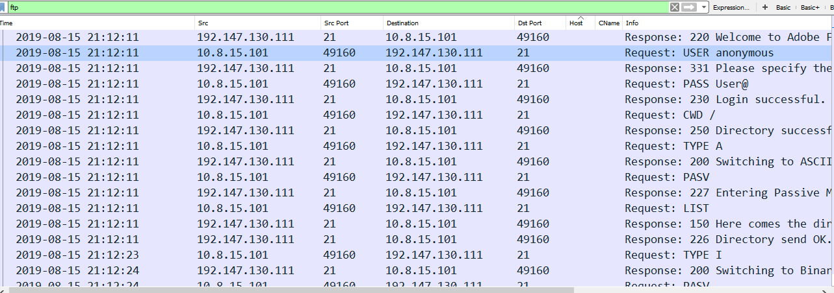
Notes:
Filtering for FTP we can see the Response code.
220- is new user connecting to ftp server.

Slide 40
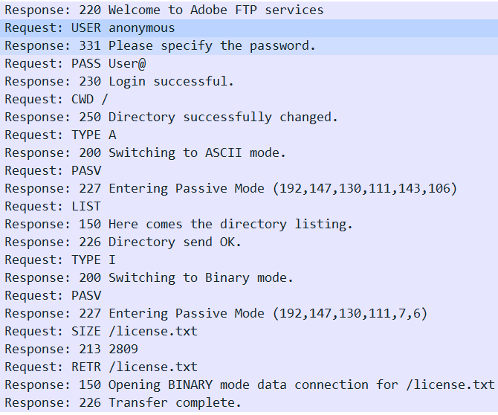
220-New user
331-User name okay, need password
230- User logged In
250 – Request File
Completed action
150- open data connection
226- requesting file successful
213- File status
226- closing data connection, requested file successful.
Notes:
You can view the entire FTP session step by step by analyzing the response code.

Slide 41
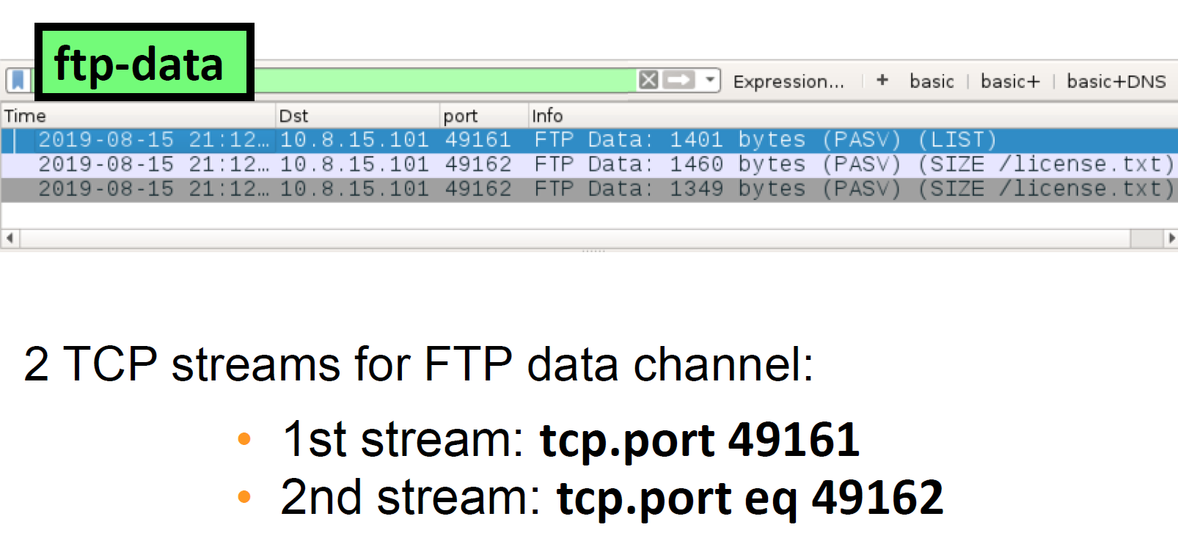
Notes:
Filtering for ftp-data we can see 2 tcp streams for FTP data channel.

Slide 42
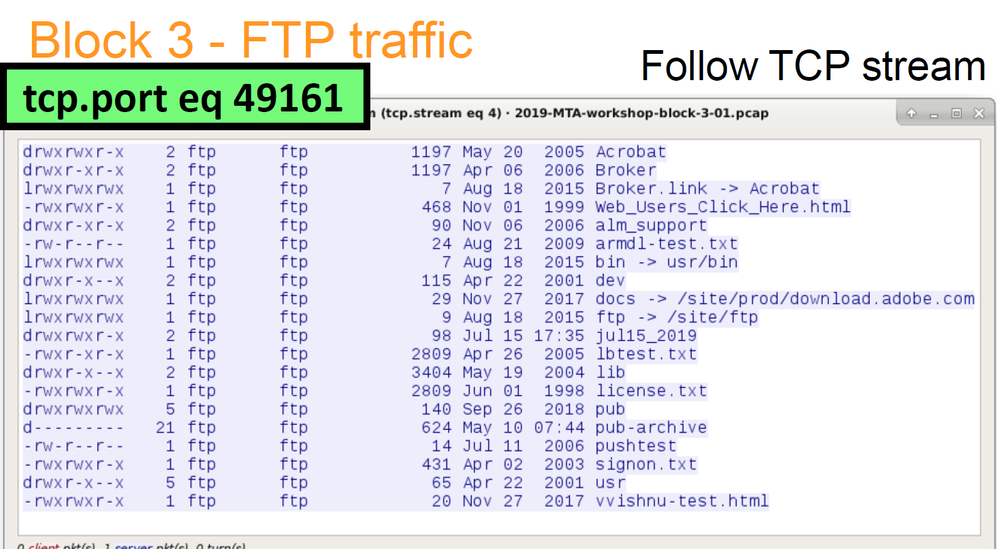
Notes:
Following the first stream we can see the contents of the directory and the file permissions

Slide 43
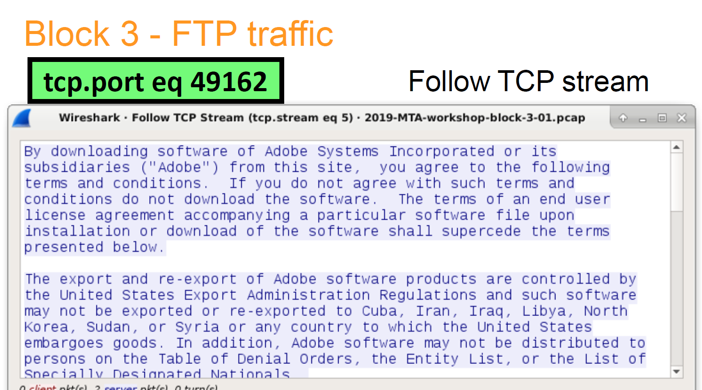
Notes:
Analyzing the second stream we can see the actual contents of the package itself.

Slide 44
Non-Malicious Activity
Filtering for non-web traffic
Email Traffic
FTP Traffic
IRC Traffic
File Transfers over SMB
Traffic caused by Google Chrome

Slide 45
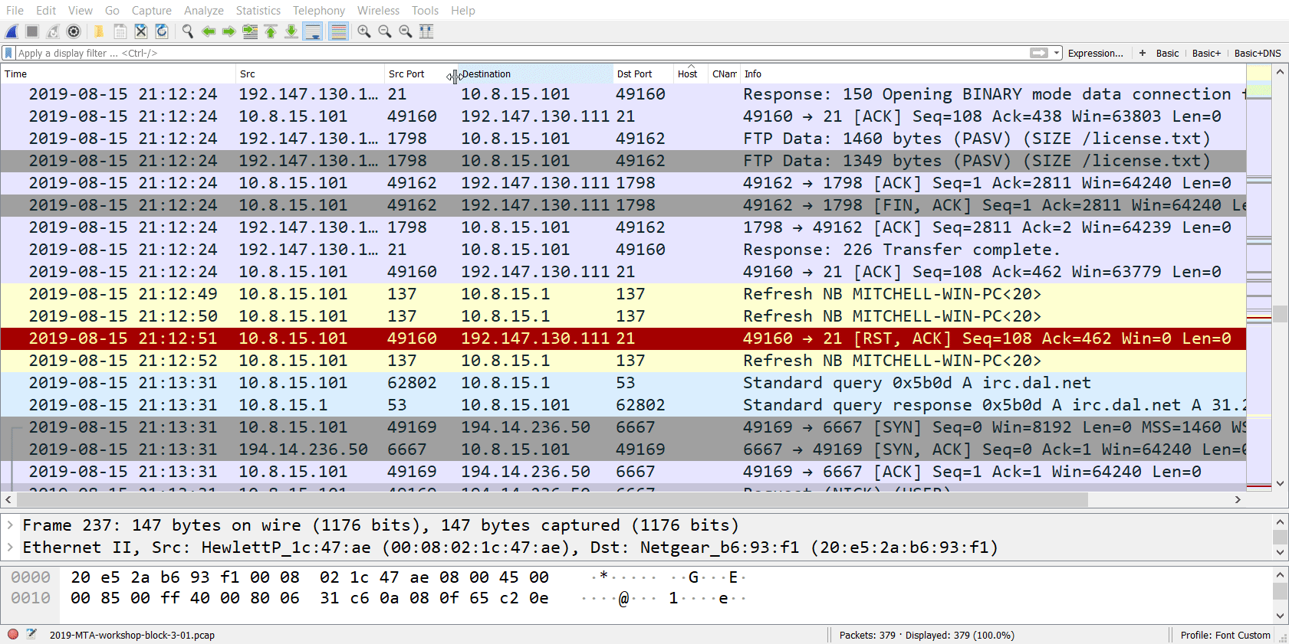
Notes:
Filtering for IRC traffic will display the IRC chat log
There's more you can do with IRC but you will need to have Wireshark setup to decode traffic on port 6668

Slide 46
Non-Malicious Activity
Filtering for non-web traffic
Email Traffic
FTP Traffic
IRC Traffic
File Transfers over SMB
Traffic caused by Google Chrome

Slide 47
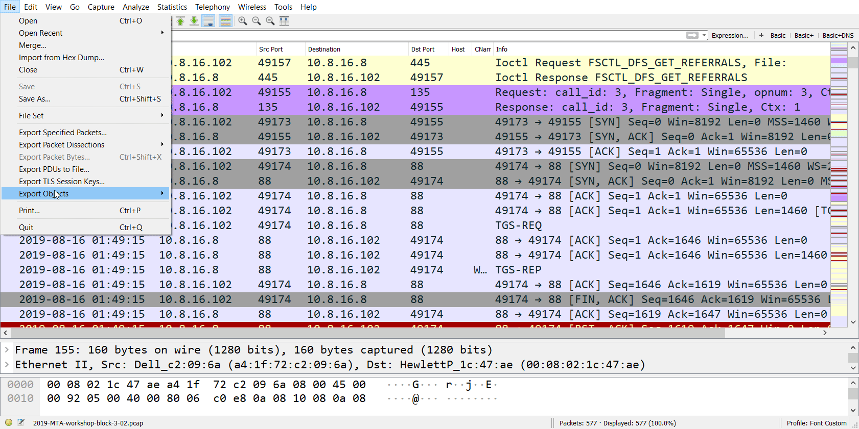
Notes:
To see files transferred over SMB:
File > Export Object > SMB

Slide 48
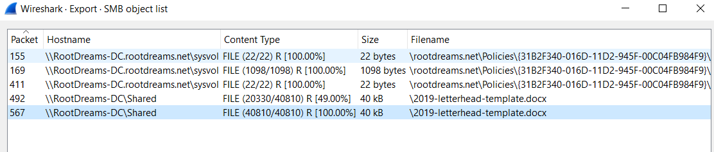
Notes:
Letterhead template.docx
You can save the file and examine.

Slide 49
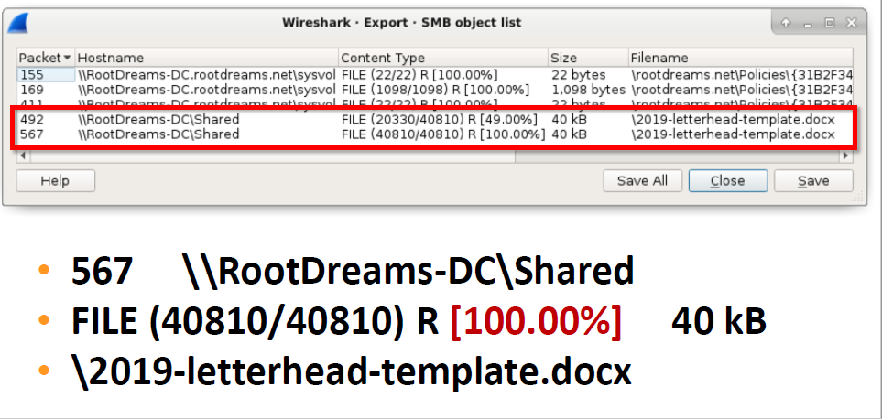

Slide 50
Non-Malicious Activity
Filtering for non-web traffic
Email Traffic
FTP Traffic
IRC Traffic
File Transfers over SMB
Traffic caused by Google Chrome

Slide 51
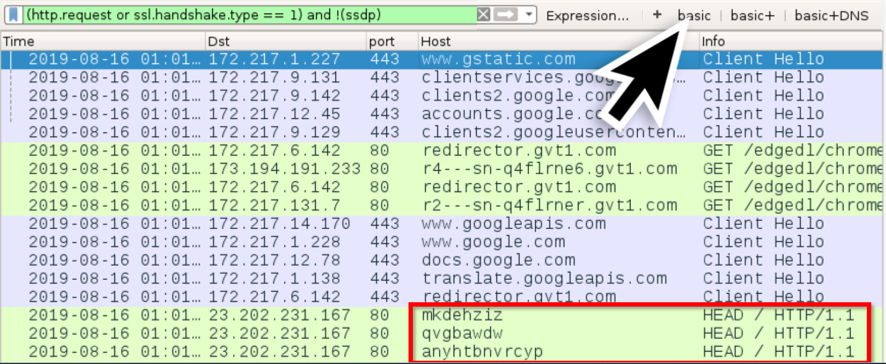
Notes:
When opened, the google chrome browser sometimes generates random alphabetic strings as HTTP HEAD Requests.

Slide 52
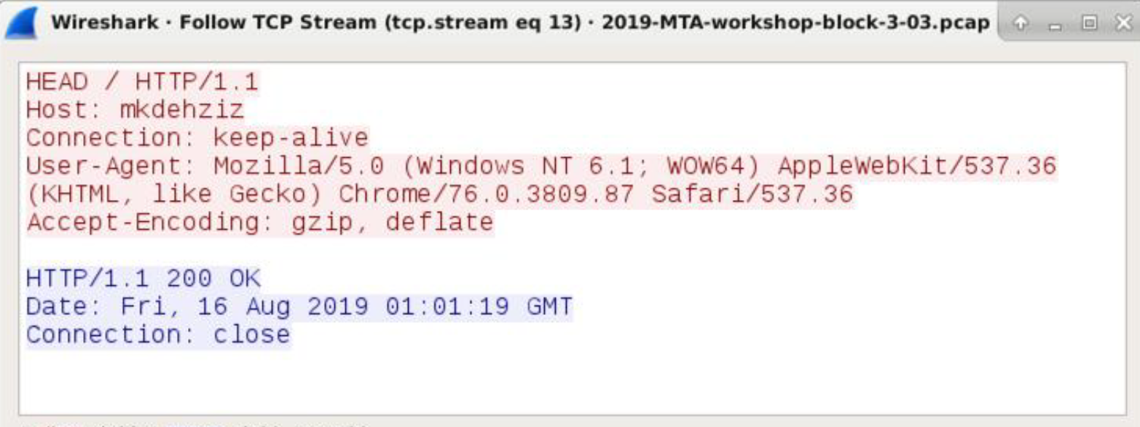
Notes:
Go to LIVE DEMO

Slide 53
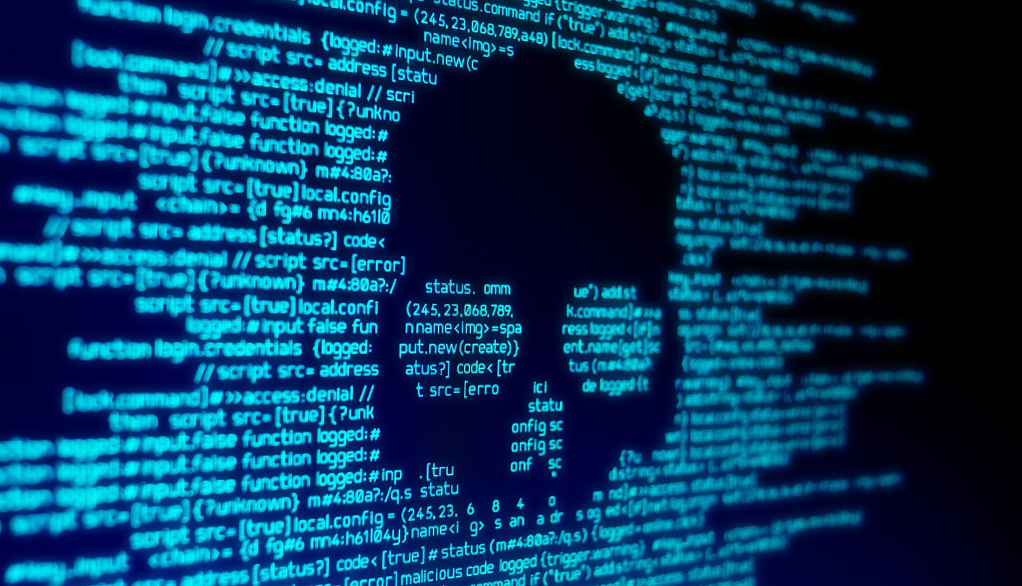
Notes:
Windows Malware Infections

Slide 54
Windows Malware Infections
Commodity malware infections
Lokibot
Formbook
Ursnif
Info Stealer using FTP
Trickbot
Emotet
Monero Cryptocurrency Miner

Slide 55
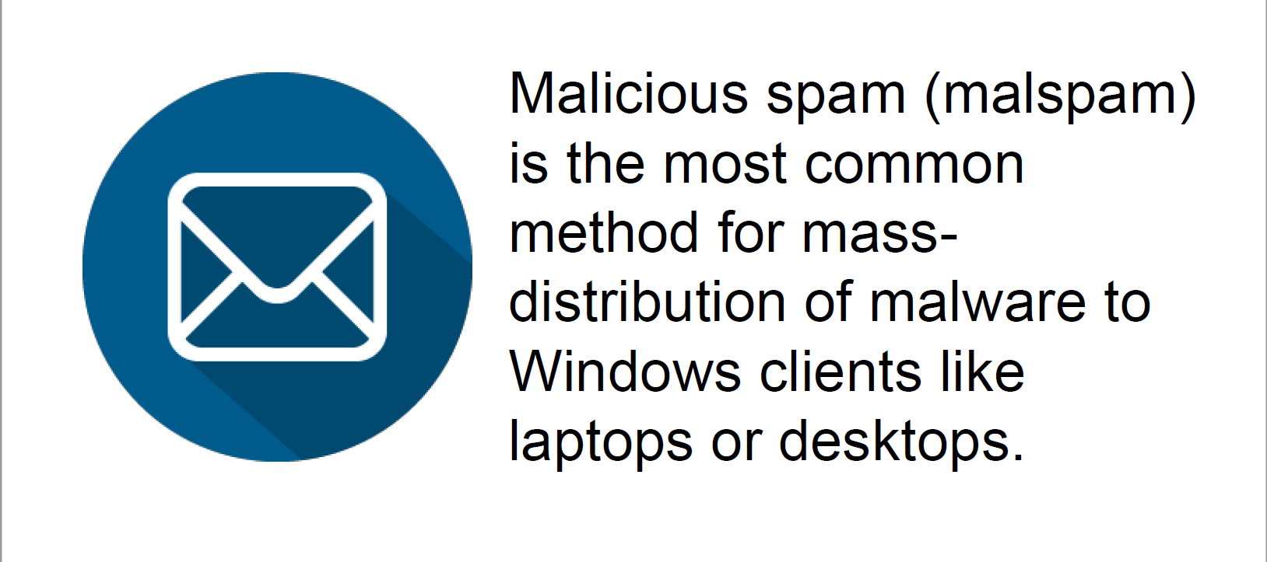
Notes:
Malspam-based malware distribution uses two general methods:
Attachments or links

Slide 56
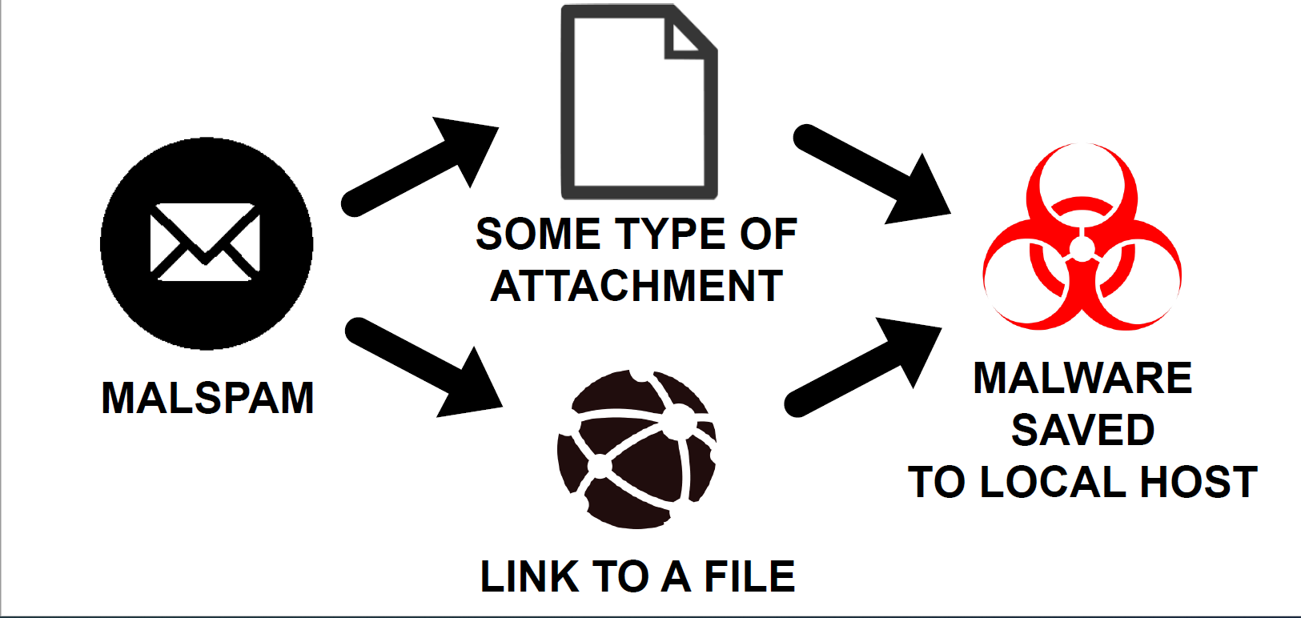

Slide 57
Windows Malware Infections
Commodity malware infections
Lokibot
Formbook
Ursnif
Info Stealer using FTP
Trickbot
Emotet
Monero Cryptocurrency Miner
Notes:
Loki Bot. The malware's key objective is to steal passwords from browsers, messaging applications, mail and FTP clients, and cryptocurrency wallets.

Slide 58
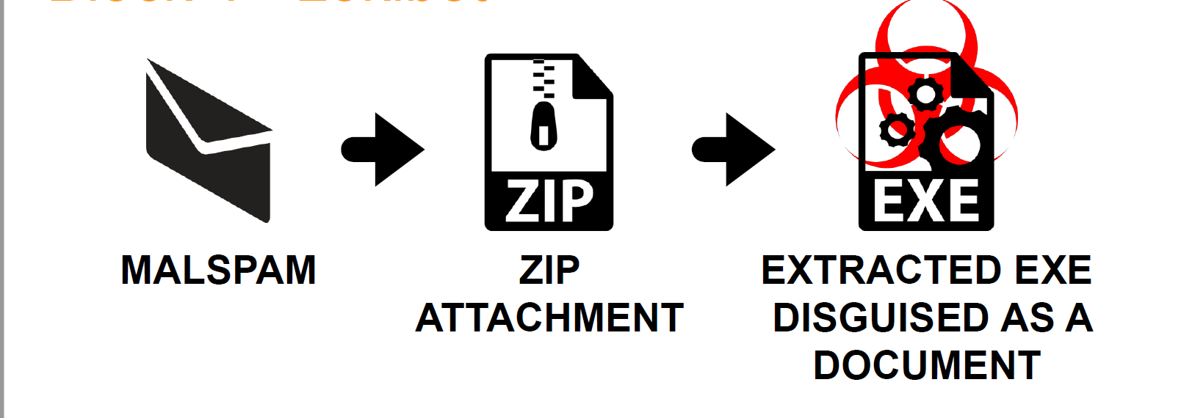
Notes:
Lokibot is typically delivered through malspam

Slide 59
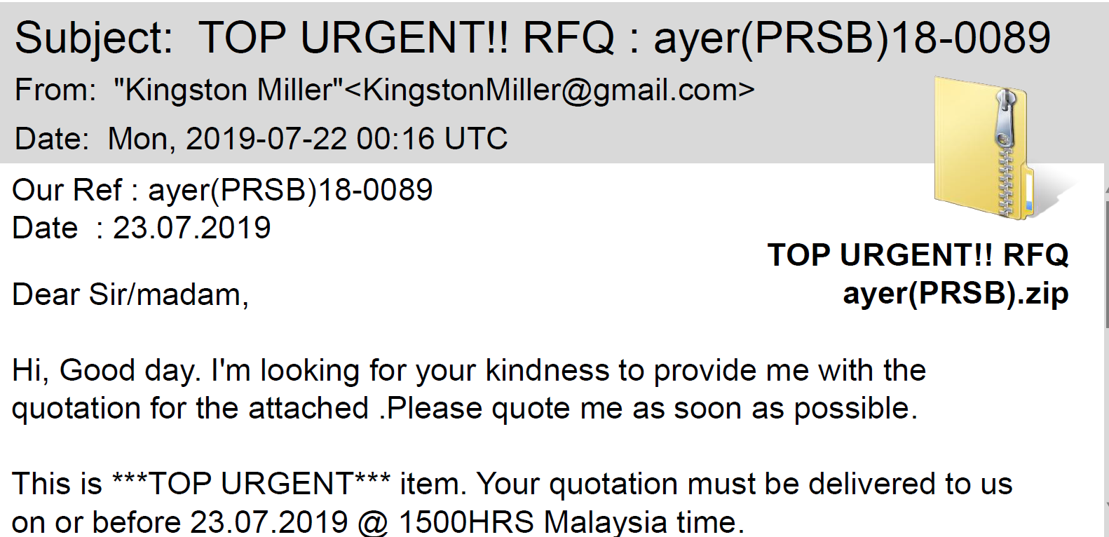
Notes:
Typically in something like that.

Slide 60
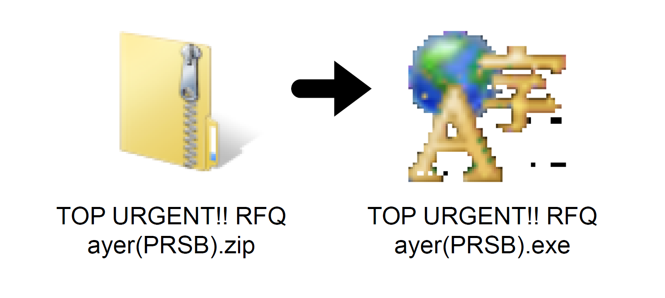
Notes:
Extract the zip. It will have an icon. Most people will launch it.
And then BOOM

Slide 61
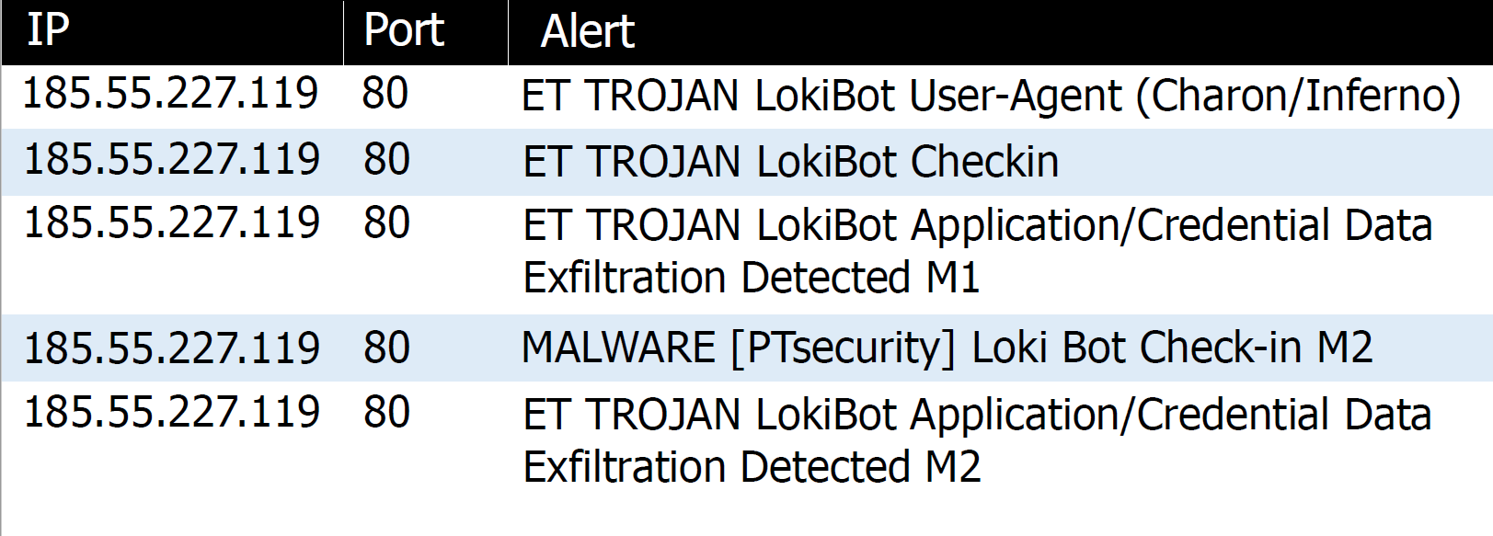
Notes:
IOC’s pop off and its another 70 hour work week cause people forwarded it around the office.
Lets go to a live demo!
B4-P1

Slide 62
Windows Malware Infections
Commodity malware infections
Lokibot
Formbook
Ursnif
Info Stealer using FTP
Trickbot
Emotet
Monero Cryptocurrency Miner
Notes:
Formbook is a data stealing malware which is capable of stealing data from web browsers and many other applications. Formbook has been for sale on underground hacking forums since early 2016.

Slide 63
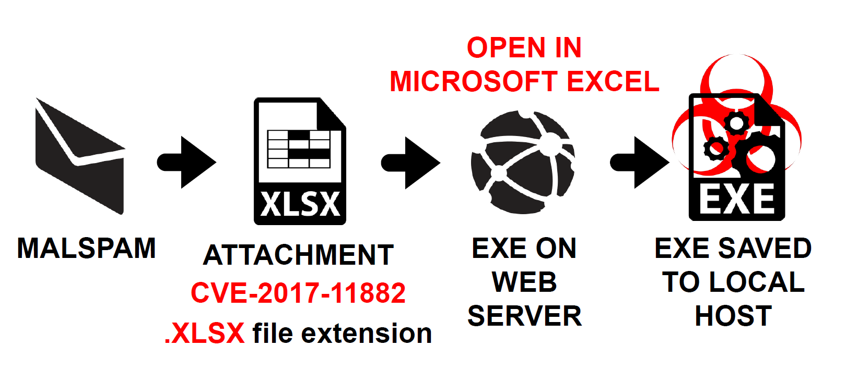
Notes:
Formbook typically comes in malspam.

Slide 64
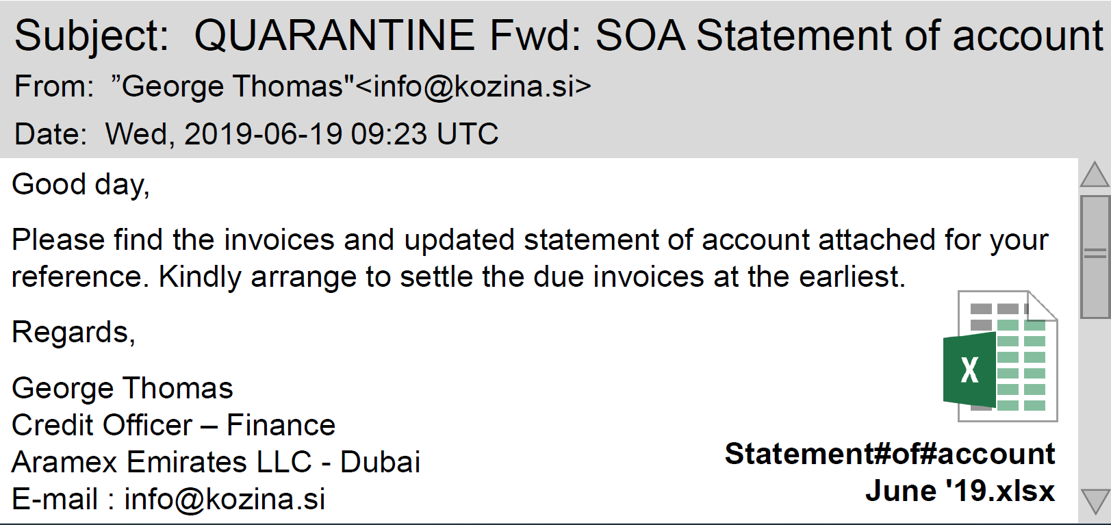

Slide 65
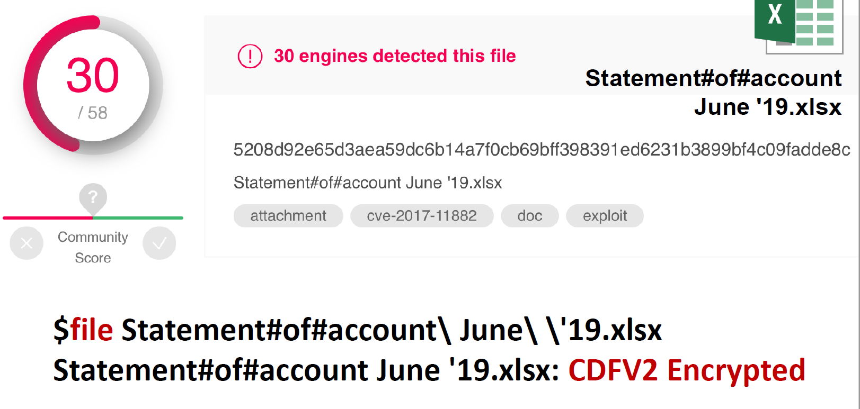
Notes:
Checking it on virus total.
Virus total is publicly available, so attackers will watch that site to see if anyone has discovered.

Slide 66
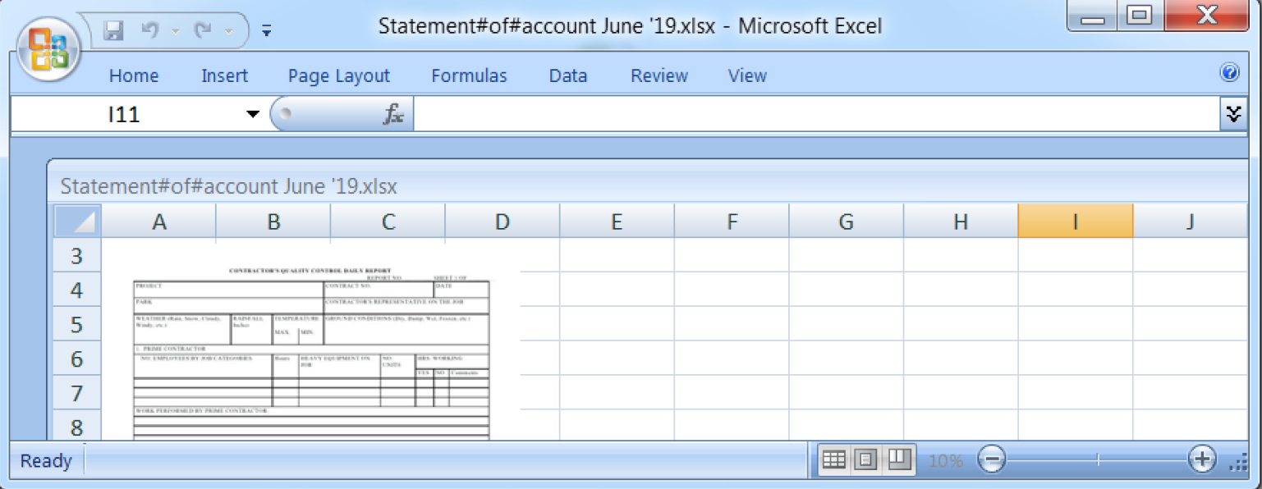
Notes:
Open the file it is indeed a spreadsheet but with a picture of a form.

Slide 67
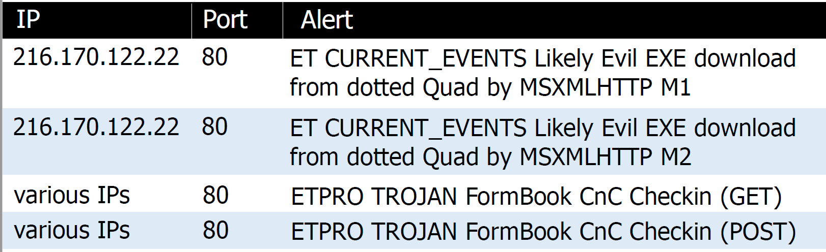
Notes:
IOC’s
LIVE DEMO
B4 – P2

Slide 68
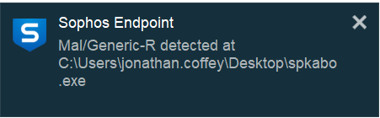

Slide 69
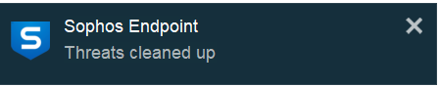

Slide 70

Notes:
Run these commands.
File will return the type
SHA SUM will return the sha 256 and you can google that instead of uploading to virus total.

Slide 71
Windows Malware Infections
Commodity malware infections
Lokibot
Formbook
Ursnif
Info Stealer using FTP
Trickbot
Emotet
Monero Cryptocurrency Miner
Notes:
Ursnif, also known as Dreambot, has been around for some time and initially focused on stealing emails and online banking credentials from browsers. ... The attack chain starts off with spam emails that carry Word documents containing malicious macro scripts

Slide 72

Notes:
Initially arrives in the environment through malspam. In the form of probably a password protected zip attachment. Unzip it’s a word doc with maros. That reaches out to the internet and downloads the Ursnif exe. It also installs follow up malware for persistence. Which we can hit on with our IOC.

Slide 73

Notes:
See the sequence of events after the payload has been processed.

Slide 74


Slide 75

Notes:
Filtering by basic we can see the get request to msftncsi

Slide 76

Notes:
Ursnif is the initial infection. Nymaim is the follow up malware.

Slide 77

Notes:
Returned a EXE File

Slide 78

Notes:
We can see this https traffic with no domain

Slide 79

Notes:
Filtering for tls handshakes we can see the host

Slide 80

Notes:
Filtering for tls.handshake.type 11 I believe is finish message we can see the full certificate and server key exchange.

Slide 81

Notes:
Digging down into the transport layer and handshake protocol we can dive down till it displays the issuer of the signed certificate.

Slide 82

Notes:
Bad certificate.

Slide 83

Notes:
Normal certificate.

Slide 84

Notes:
Going back to the capture. We see the return for the follow up malware

Slide 85


Slide 86

Notes:
Now were starting to see the call back traffic

Slide 87

Notes:
This is an example of the command and control Ursnif

Slide 88

Notes:
Bringing it all together we have a picture of the infection.
From original Ursnif exe to decoy traffic to callback.

Slide 89
Windows Malware Infections
Commodity malware infections
Lokibot
Formbook
Ursnif
Info Stealer using FTP
Trickbot
Emotet
Monero Cryptocurrency Miner

Slide 90

Notes:
Same flow as typical. Spam > zip > extracted exe.
GO LIVE DEMO. B4-P5

Slide 91

Notes:
Back to live demo! B4-P6

